Slide 1
Agile development
TUHE - 2017

Slide 2
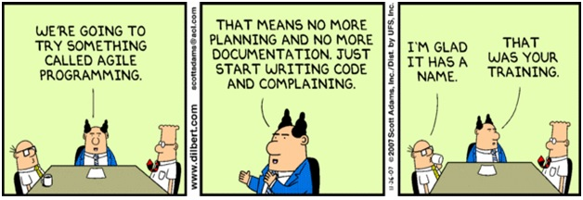

Slide 3
Agile development
Know
That systems development is an independent discipline
Inherent challenges in sw-development
Background for the agile movement
Intentions expressed in the agile manifesto and related works
Characteristics of agile approaches to software development
Be able to
Select appropriate means and tools when communicating in agile environments

Slide 4
Resources
Fowler The new Methodology http://martinfowler.com/articles/newMethodology.html
Manifesto for Agile Software Development http://agilemanifesto.org
Ambler Communication on Agile Software Teams http://www.agilemodeling.com/essays/communication.htm
Martin Fowler and Niel Ford, 2010 Video - 40 min - conference talk http://www.usievents.com/en/videos/35-explaining-agile-martin-fowler

Slide 5
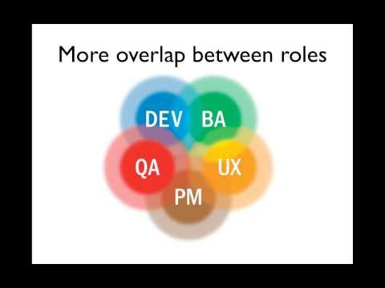
Agile In a Nutshell

Slide 6
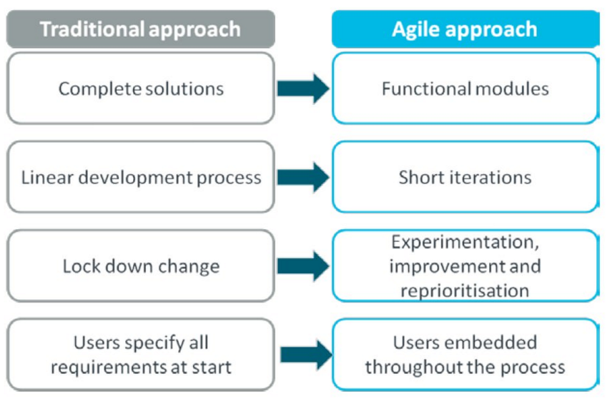
Agile overview

Slide 7
Manifesto for Agile Software Development
We are uncovering better ways of developing software by doing it and helping others do it.
Through this work we have come to value:
Individuals and interactions over processes and tools
Working software over comprehensive documentation
Customer collaboration over contract negotiation
Responding to change over following a plan
That is, while there is value in the items on the right, we value the items on the left more.
http://agilemanifesto.org

Slide 8
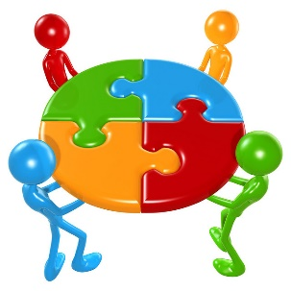
Principles behind the Agile Manifesto
Our highest priority is to satisfy the customer through early and continuous delivery of valuable software.
Welcome changing requirements, even late in development. Agile processes harness change for the customer's competitive advantage.
Deliver working software frequently, from a couple of weeks to a couple of months, with a preference to the shorter timescale.
Business people and developers must work together daily throughout the project.
Build projects around motivated individuals. Give them the environment and support they need, and trust them to get the job done.
The most efficient and effective method of conveying information to and within a development team is face-to-face conversation.
Working software is the primary measure of progress.
Agile processes promote sustainable development. The sponsors, developers, and users should be able to maintain a constant pace indefinitely.
Continuous attention to technical excellence and good design enhances agility.
Simplicity--the art of maximizing the amount of work not done--is essential.
The best architectures, requirements, and designs emerge from self organizing teams.
At regular intervals, the team reflects on how to become more effective, then tunes and adjusts its behavior accordingly.
http://agilemanifesto.org/principles.html

Slide 9
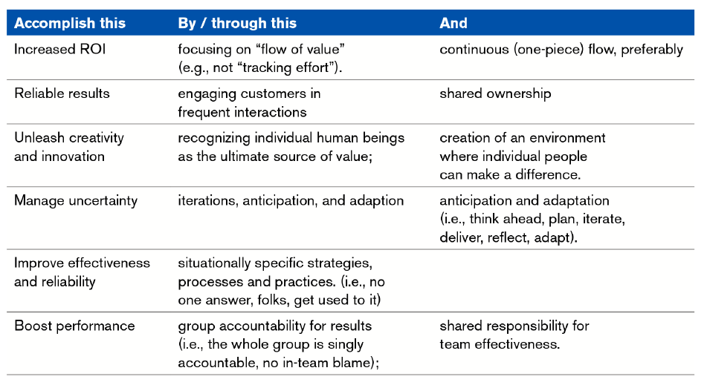
Modern principles of Agile

Slide 10
Agile <> Plan
Agile
People First
Plan Driven
Process First

Slide 11
Agile methodologies
“Agile methods are adaptive rather than predictive. Engineering methods tend to try to plan out a large part of the software process in great detail for a long span of time, this works well until things change. So their nature is to resist change. The agile methods, however, welcome change. They try to be processes that adapt and thrive on change, even to the point of changing themselves.”
“Agile methods are people-oriented rather than process-oriented. The goal of engineering methods is to define a process that will work well whoever happens to be using it. Agile methods assert that no process will ever make up the skill of the development team, so the role of a process is to support the development team in their work.”
Martin Fowler - http://martinfowler.com/articles/newMethodology.html

Slide 12
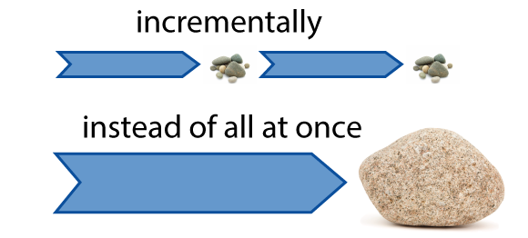
What is Agile?
Agile is a time boxed, iterative approach to software delivery that builds software incrementally from the start of the project, instead of trying to deliver it all at once near the end.

Slide 13
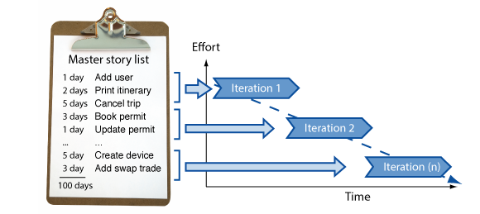
How does it works?
It works by breaking projects down into little bits of user functionality called user stories, prioritizing them, and then continuously delivering them in short two week cycles called iterations.

Slide 14
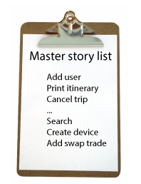
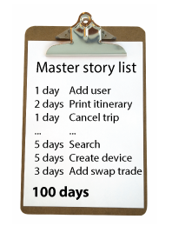
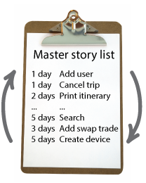
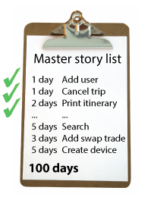
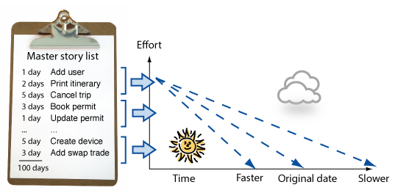
How does it work?
You make a list
You size things up
You set some priorities
You start executing
Sitting down with your customer you make a list of features they would like to see in their software. We call these things user stories and they become the To Do list for your project.
Then, using Agile estimation techniques, you size your stories relatively to each other, coming up with a guess as to how long you think each user story will take.
Like most lists, there always seems to be more to do than time allows. So you ask your customer to prioritize their list so you get the most important stuff done first, and save the least important for last.
Then you start delivering some value. You start at the top. Work your way to the bottom. Building, iterating, and getting feedback from your customer as you go.
You update the plan as you go
Then as you and your customer starting delivering one of two things is going to happen. You'll discover:
You're going fast enough. All is good. Or,
You have too much to do and not enough time.
At this point you have two choices. You can either a) do less and cut scope (recommended). Or you can b) push out the date and ask for more money.

Slide 15
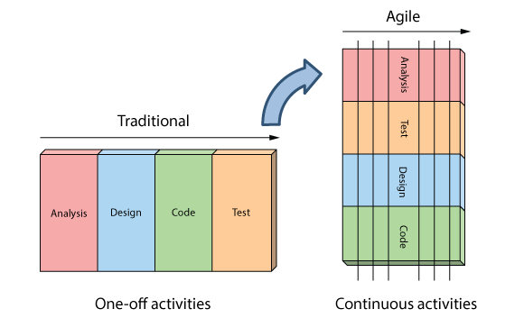
How is Agile different?
Analysis, design, coding, and testing are continuous activities
You are never done analysis, design, coding and testing on an Agile project. So long as there are features to build, and the means to deliver them, these activities continue for the duration of the project.

Slide 16
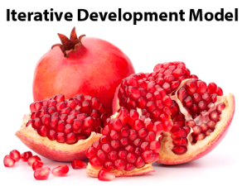
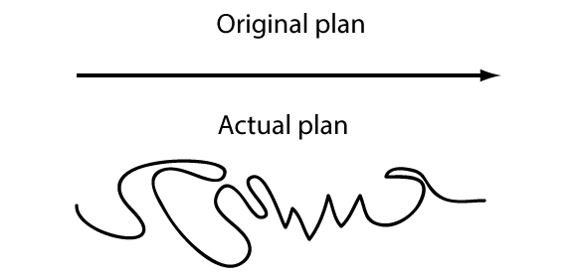
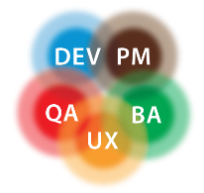
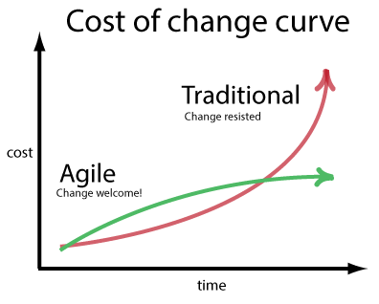
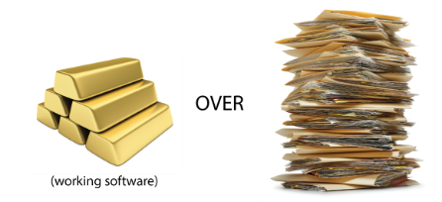
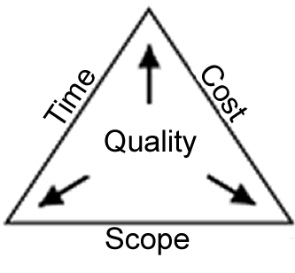
How is Agile different?
Development is iterative
Planning is adaptive
Roles blur
Iterative development means starting with something really simple, and adding to it incrementally over time.
It means evolving the architecture, accepting that your requirements are going to change, and continuously refining and tweaking your product as you go.
When reality disagrees with their plans, Agilists find it easier to change their plans than reality. They call this adaptive planning.
And while there are many ways to changes plans, the preferred way is to flex on scope.
Roles really blur on Agile projects. When it’s done right, joining an Agile team is a lot like working in a mini-startup. People pitch in and do whatever it takes to make the project successful—regardless of title or role.
Yes, people still have core competencies, and, yes, they generally stick to what they are good at. But on an agile project, narrowly defined roles like analyst, programmer, and tester don’t really exist - at least not in the traditional sense
Scope can vary
Requirements can change
Working software
Agile deals with the age old problem of having too much to do and not enough time by doing less.
By fixing time, budget, and quality, and being flexing around scope, Agile team's maintain the integrity of their plans, work within their means, and avoid the burn out, drama, and dysfunction traditionally associated with our industry.
Traditionally change has been shunned on software projects because of it's high perceived cost late in the game. Agile challenges this notion and believes the cost of change can be relatively flat.
Through a combination of modern software engineering practices, and open and honest planning, Agilsts accept and embrace change even late in delivery process.
The rate at which teams can turn their customer's wishes into working software is how Agilists measure productivity. Project plans, test plans, and analysis artifacts are all well and good but Agilists understand they in themselves are of no value to the end customer.

Slide 17
Agile Myths
Agile is a silver bullet | Wish this were true - but it isn't. You can fail just as spectacularly on an Agile project as you can using any other traditional method. You'll fail faster using Agile (due to the transparency and visibility it brings) but unfortunately it's not a silver bullet or an excuse to stop thinking. There's nothing inherently magical about Agile. It basically says Bring your development team and customer as close together as you can, give them what they need, and then get out of the way. Now if you don't have people that like being empowered, taking initiative, and getting things done, that's a different problem. Agile just gives them permission to do their best work and be accountable for the results.
Agile is anti-documentation | Agile isn't anti-documentation. A more accurate way to say it would be Agile doesn't do documentation for documentation's sake. Documentation gets treated like any other deliverable on an Agile project. It gets estimated, sized, and prioritized like any other user story. Where Agile pushes back on documentation is as a means of communication. Agile prefers face-to-face communication over relying on the written word.
Agile is anti-planning | Not sure where this one comes from. There's actually a lot of planning that goes on in Agile projects. You've got your: Daily planning with the 10 minute daily standups. Bi-weekly planning with the Iteration/Sprint Planning Meetings Release planning where team's decide what to ship every three to four months. But it wouldn't be fair to say Agile is anti-planning. If anything it is anti-static planning. Meaning Agilist's expect their plans to change and use tools like burndown charts to track and make these changes visible
Agile is undisciplined | When Agile started gaining popularity, its reputation suffered a bit from some teams taking the easy parts of Agile (like attending daily standups) but leaving out the hard (like upfront testing and regularly shipping production ready working software). The truth is Agile is a very disciplined way of delivering software. You have to test. You have to get feedback. You have to regularly ship software. You have to change and update the plan. You have to deliver bad news early. This isn't easy stuff. It's not for the faint of heart and requires a lot of hard work, courage, and discipline.
Agile requires a lot of rework | Rework comes in two forms on an Agile project. You've got the rework of requirements - customers discovering what they really want. And you've got the rework of the software - development teams discover better ways to design the software. Both need to be balanced and tempered. Just as business can't indefinitely keep changing their mind, development teams can't forever keep redesigning the software. At some point we have to ship. Agile deals with this tension by empowering both sides with the power to iterate, so long as they work within the project's means. Burndown charts play in big role in tracking how Agile project are doing. Just as tools like the Agile Inception Deck make sure everyone is on the same page with regards to time and money. It's a balancing act not unique to software delivery. Any creative work with a deadline (i.e. plays, movies making, or the publishing of daily papers) faces the same challenges. The trick is to do the best work you can, with the time and resources you've got.
Agile is anti-architecture | Something we got really good at as an industry in the 1990's was building big, complex, expensive, hard to maintain systems. Agile pushed back on this over engineering by creating terms like YAGNI (You Aint Gonna Need It) to remind teams to keep things simple until proven otherwise. That doesn't mean Agile teams stop thinking, or don't leverage previous experiences. It's more an attitude that the best way to build systems is to keep things simple, and only add the complexity when you need it.
Agile doesn't scale | Agile scales like any other software delivery process. Not that well. Look - scaling is hard. There is no easy way to magically coordinate, communicate, and keep large groups of people all moving in the same direction towards the same cause. It's hard work. The one thing Agile does bring to the conversation, is instead of looking for ways to scale up your project, look for ways to scale things down. In other words, if we know we are really good at delivering with small, nimble, agile teams of ten, why don't we structure our work that way.

Slide 18
Process models and Methods
Methods have a more or less defined scope
Methods have an underlying perspective
Methods provides guidelines for how the process should proceed:
The sequence in which to carry out the functions
The artefacts to produce
Process models is a grouping of methods with similar characteristics
Process models are also called paradigms

Slide 19
What’s a process model and a method?
Process models are differentiated by their sequence of activities
For instance, first full analysis, then design …
Methods are differentiated by the content of the activities
For instance:
Which activities are carried out during design?
Which models are made during analysis?

Slide 20
How to choose an approach?
Define the Task at hand
Choose a process model which suits the task
Choose a method within the process model
Use the recommended techniques and tools
Situation
Process models
System development methods
Techniques
Tools
BUT …never be mechanistic:
Adapt the method
Perhaps combine methods
Be pragmatic
Focus on approaches that works
Remember:
There is no silver bullet
Death over standard methods!

Slide 21
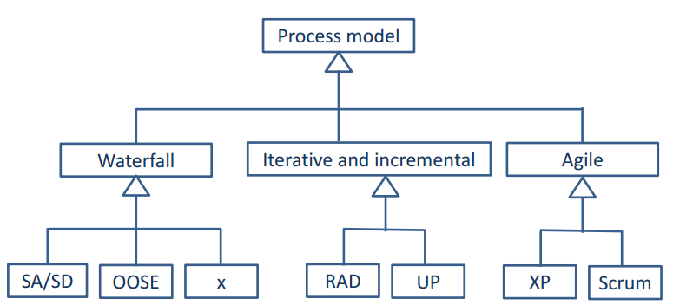
Process models

Slide 22
Exercise from ”I am Agile”
Which of the four statements found in the Agile Software Development Manifesto are highlighted in this case?
Which of the twelve principles of Agile software are illustrated in the case?
Case page 55 - 57 – ”Before it was called Agile”
(PDF on Fronter eller https://www.dropbox.com/s/qfz8hf0t6va3ni4/Before%20it%20was%20called%20Agile.pdf?dl=0 )

Slide 23
Communication
Communication (from Latin commūnicāre, meaning "to share") is the purposeful activity of information exchange between two or more participants in order to convey or receive the intended meanings through a shared system of signs and semiotic rules

Slide 24
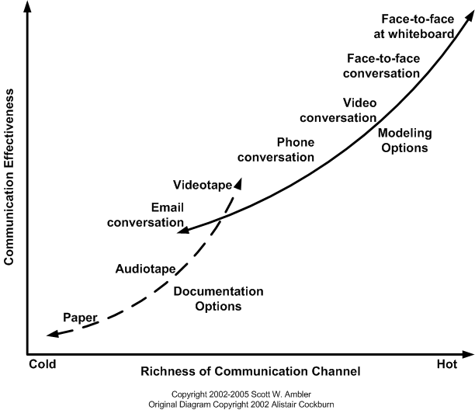
How Do We Communicate?
http://www.agilemodeling.com/essays/communication.htm

Slide 25
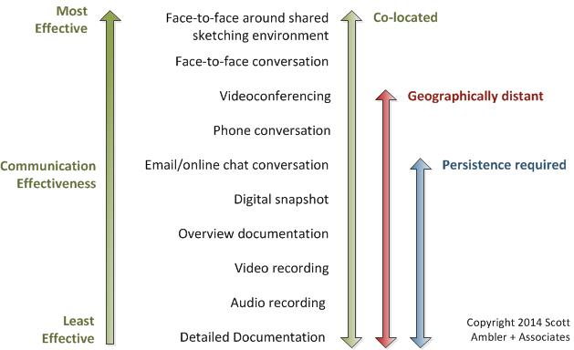
Implication of the modes of communication
http://www.ambysoft.com

Slide 26
User Stories
In software development and product management, a user story is a description consisting of one or more sentences in the everyday or business language of the end user or user of a system that captures what a user does or needs to do as part of his or her job function.

Slide 27
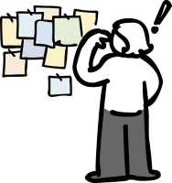
User Stories
User stories are features our customers might one day like to see in their software.
User stories are like Agile requirements except that they’re not.
For one there’s no guarantee all these features are going to make it into the final version of the software.
Secondly, Agilists know their customers are going to change their mind - and that’s OK. Because they weren’t really requirements to begin with.

Slide 28
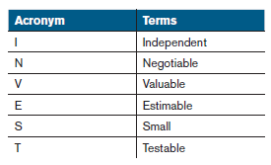
The format of a user stories
As a <role> I can <activity> so that <business value>
As a Consumer, (<role>) I want to be able to see my daily energy usage (<what I do with the system>) so that I can start to understand how to lower my costs over time (<business value I receive>)”.

Slide 29
Writing good User Stories
I
N
V
E
S
T
ndependent
egotiable
aluable
stimable
mall / appropriately sized
estable

Slide 30
Splitting User Stories
User story generally starts out as a feature or an epic – a large, vague concept of something we want to do for a user.
There is no set routine for splitting user stories into iteration-sized bites, other than the general guidance to make each story provide a vertical slice, some piece of user value, through the system.
All in all we split user stories when the user story is too large to fit within one iteration or in order to make estimates more accurate, if the user story is epic.

Slide 31
CRUD
CRUD = (Create / Read / Update / Delete)
Split into smaller stories – Example:
As a online store owner, I want to Create / Read / Update / Delete products so that I can offer my customers the top rated products
As a online store owner, I want to Read (view) my products so that I can review what is current available on my site
… I want to Create / Update a product so that I can offer my customers the top rated products
… I want to Delete a product so that I can offer my customers the top rated products

Slide 32
Acceptance Criteria
Bring the project from ”It Works as Coded” to “It Works as Intended”
Are conditions that a story must satisfy to be accepted by a user, customer or other stakeholder (PO in Scrum)
Are a set of statements, each with a clear pass/fail result, that specify both functional and non-functional requirements
Functional example: When a user clicks on the ‘Reports’ dropdown, a list of available reports will be displayed.
Non-functional example: Form edit buttons will be blue, and Form workflow buttons will be green.

Slide 33
User story example
User story: As an Administrator, I want to be able to create User Accounts so that I can grant users access to the system
Acceptance Criteria:
If I am an Administrator, I can create User Accounts.
I can create a User Account by entering the following information about the User: a. Name, b. Email address, c. Phone Number d. License Number (Power/Basic/None), e. Account Status (Active/Inactive), f. Reports to (from a list of "Active" Users)
I cannot assign a new User to report to an “Inactive” User
I cannot assign a new User to report to a User if it creates a cyclical relationship (e.g., User 1 reports to User 2 who reports to User 1
The system notifies me that it sent an email to the new User's email address, containing a system-generated initial password and instructions for the person to log in and change their password.
I am able to verify with the intended recipient of the email that it was received.
Source: http://www.seguetech.com/blog/2013/03/25/characteristics-good-agile-acceptance-criteria

Slide 34

User stories and outsourcing
User stories has to be so simple that a freelancer or outsourced team would easily be able to understand the end goals

Slide 35
User stories ”problems”
Stories are too small
Stories are epic
Interdependent stories
Goldplating (Adding unnecessary things)
Too many details
Including user interface detail too soon
Thinking too far ahead
Splitting too many stories
Customer has trouble prioritizing
Customer won’t write and prioritize the stories.

Slide 36
Exercise User Stories
See how many user stories you can write about logging in
Examples
As a registered user, I am required to log in so that I can access the system
Use this template
“As a <user role>, I want <goal> so that <reason>.”

Slide 37
Exercise User Stories
Employees can purchase parking passes.
As an employee I want to purchase a parking pass so that I can drive to work.
Notes:
Buyer is charged fee for 1 month only
One pass for one month is issues at a time
No pass is issued if payment is insufficient
Buyer must be a current employee
Any employee can only buy one pass per month

Slide 38
Powered By GitHub
Tool - Waffle.io
Waffle stays in sync with your GitHub repositories. Continue to work in GitHub when it makes sense.
Use Waffle when it saves you time over browsing through lists of Issues.
Wherever you choose to work, we'll keep your Waffle board updated in real time.
See how easily Waffle lets you visualize your work in progress and prioritize what to work on next

Slide 39
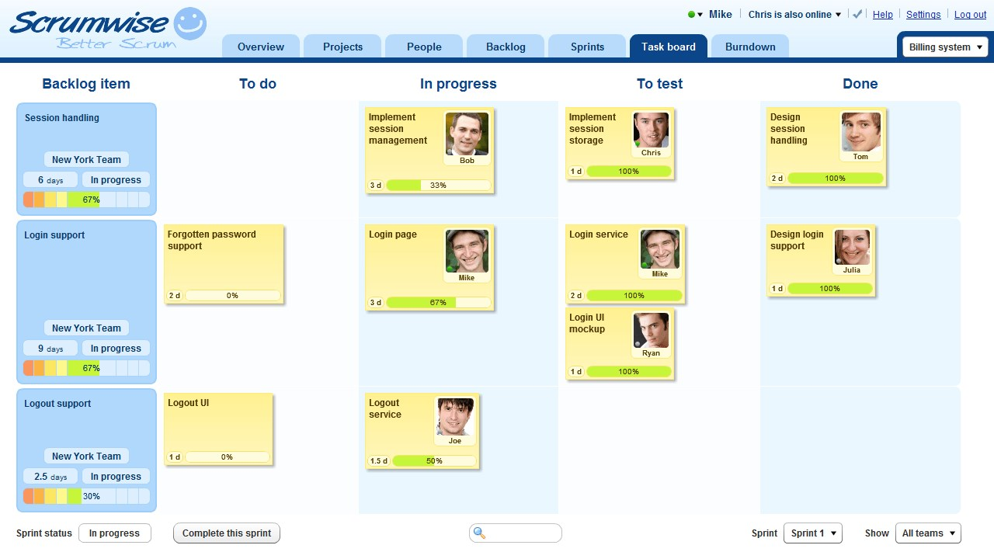
Tool - Scrumwise.com
The easiest Scrum tool you'll find Scrumwise lets you focus on your Scrum, giving you faster results, better teamwork, and better communication.

Slide 40
Estimation
The fine art of expectation guessing

Slide 41
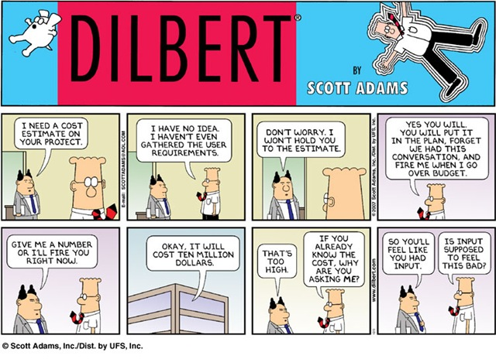

Slide 42
Estimation challenges
Ambiguous/changing requirements are hard to estimate.
Difficult to predict what exactly will be delivered when.
Estimating takes too long and we still don’t get it right.
Estimates are provided by the wrong people (not the ones doing the actual work).
Software projects are unique and ambiguous, hard to provide exact estimates.
Business customers promise unrealistic deadlines then tell the team to make it work.
Commitments are signed based on high level estimates.
Fixed Scope, Time, Budget!
“Estimates” are expected to NOT Change.

Slide 43
Agile Estimation
Agile estimation is much about setting the expectations and about the time required to complete the software among the stakeholders, the team, and the organization’s management.
If those expectations are not realistic from the beginning of the project, the stakeholders will not trust the team.
Estimating is about reducing the uncertainty to a minimum, measuring the effort needed to complete the tasks at hand and at the same time taking the complexity of the tasks into account. In order to have a basis for our estimation, we apply a range of tools and techniques that takes uncertainty, effort and complexity into account.

Slide 44
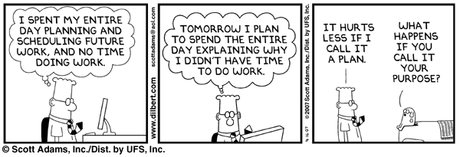
Estimation tips
Don't estimate alone
Estimate in a range not in exact numbers
Add some documentation to the estimate
Make the triangulation (compare) with the user stories
Use historical data for et estimate

Slide 45
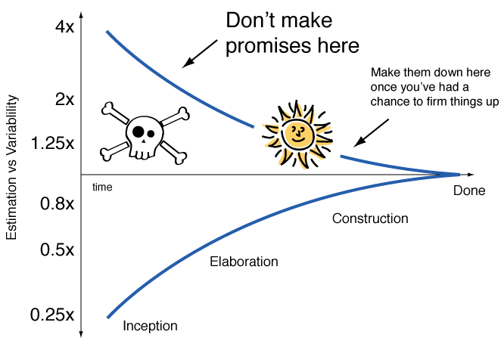
Cone of Uncertainty - Promises
http://en.wikipedia.org/wiki/Cone_of_Uncertainty

Slide 46
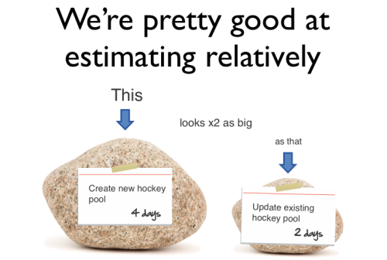
Relative sizing
The concept of relative sizing is to estimate the size of a function or user story based on the size of another one.

Slide 47
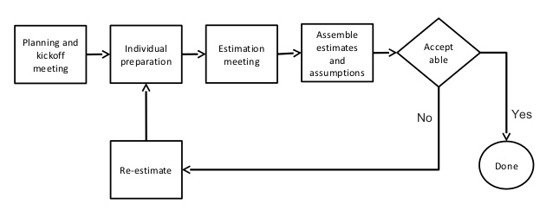
Widebrand Delphi
Team Selection
Kickoff Meeting
Individual Preparation
Estimation Session
Tasks Assembly
Results Review
Wideband Delphi is a repeatable estimation process because it consists of a straightforward set of steps that can be performed the same way each time
Named after the Oracle at Delphi.
The Oracle would answer any question that we asked, typical very cryptically.

Slide 48
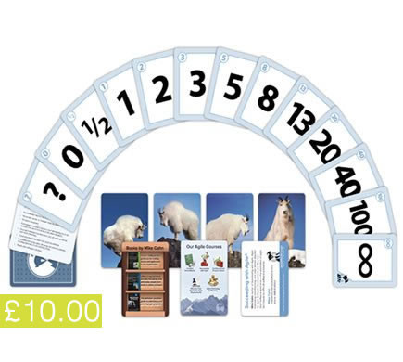
Planning Poker
Individual stories are presented for estimation.
After a period of discussion, each participant chooses from his own deck the numbered card that represents his estimate of how much work is involved in the story under discussion.
All estimates are kept private until each participant has chosen a card.
Finally, all estimates are revealed and discussion can begin again.
Planning poker is a full planning process that combines estimation with identifying the scope of the project and the tasks required to complete the project.
Similar to relative sizing, planning poker is an estimating technique used to achieve consensus on work estimate.

Slide 49
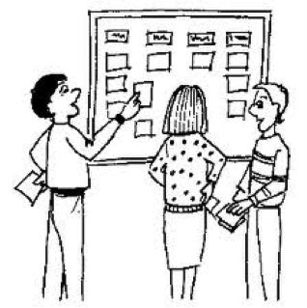
Affinity Estimation
Affinity estimating uses t-shirts or coffee cups size from:
S
M
L
XL

Slide 50
Affinity Estimation
Each stories is valued in terms of:
User interface
Business logic
Data/Integration
Testing
The values of each stories are ranked from low, medium, high to complex with the values of none, 1, 2, 3 and 4.
Each story receive total points from none to 16 which are divided into buckets of varies sizes and the bucket with the total score of 3 might be called medium.

Slide 51
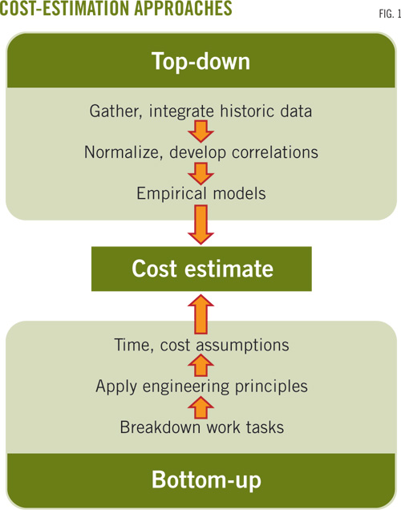
Bottom up/Top down estimation
When we estimate from activity level and up through the work breakdown structure, it is called bottom up estimates.
In Agile we do not use bottom up estimation but top down estimation.
Often the team will be involved when estimating a release. The release will be broken down into iterations and iterations into daily packages. This implies that we will get more refined estimates as we move on.

Slide 52
Three-point estimation
The three-point estimation technique is used in management and information systems applications for the construction of an approximate probability distribution representing the outcome of future events, based on very limited information
Estimate
E = (b + 4*m + w)/6
The estimate is a weighted average taking in to consideration both worst case and best case estimates
Standard deviation
SD = (b + W)/6
The standard deviation depicts the variation or uncertainty of the estimate
b
The best case estimate
m
The most likely estimate
w
The worst case estimate

Slide 53
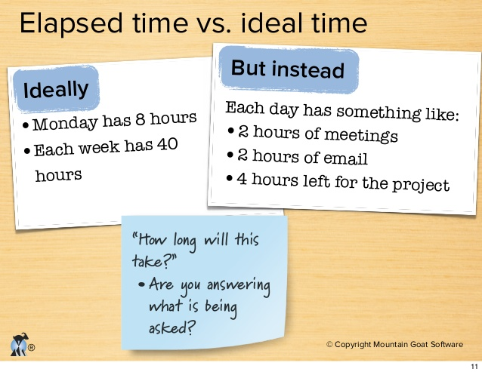
Ideal time and elapsed time
Ideal time is the time is takes to complete an assignment, story point or task without hindrances of any sort.
Elapsed time is the actual amount of
time it takes to complete a story.
Elapsed time is often similar to
calendar time

Slide 54
Exercise - Planning Poker Estimates
 | Group 1 | Group 2 | Group 3 | Group 4 | Group 5 | Answer
Denmark (5.500.000) | 100 | 100 | 100 | 100 | 100 | 100
Spain (46.000.000) | - | - | - | - | - | 836
China
Czech Republic
South Africa
Barbados
Since planning poker is unit less everything is estimated relative to something else. In this case we chose Spain as the reference point and assigned it a value of 100 – index number.
The item to be estimated is discussed, then each person chooses a card from their set that they think is the closest fit. Everyone displays their cards at the same time (the idea is that people are not influenced by each other).
Then people discuss the outliers, usually the highest and lowest numbers to see if the people who selected them had a different understanding to everyone else. After discussion people re-vote taking into account anything uncovered in the discussion.
Once everyone converges on a number that is selected as the estimate. Usually if convergence is not reached by the third vote you take the highest number or majority number.
Notes:
Denmark 5.500.000 100
Spain 46.000.000 836
Czech Republic 10.000.000 182
China 7.280.000.000 132.364
South Africa 50.000.000 909
Barbados 280.000 5

Slide 55
Planning Poker Estimates - Resultat
 | Group 1 | Group 2 | Group 3 | Group 4 | Group 5 | Answer
Denmark (5.500.000) | 100 | 100 | 100 | 100 | 100 | 100
Spain (46.000.000) | - | - | - | - | - | 836
China (1.160.000.000) |  |  |  |  |  | 21.090
Czech Republic (10.000.000) |  |  |  |  |  | 182
South Africa (50.000.000) |  |  |  |  |  | 909
Barbados (280.000) |  |  |  |  |  | 5
Since planning poker is unit less everything is estimated relative to something else. In this case we chose Spain as the reference point and assigned it a value of 100 – index number.
The item to be estimated is discussed, then each person chooses a card from their set that they think is the closest fit. Everyone displays their cards at the same time (the idea is that people are not influenced by each other).
Then people discuss the outliers, usually the highest and lowest numbers to see if the people who selected them had a different understanding to everyone else. After discussion people re-vote taking into account anything uncovered in the discussion.
Once everyone converges on a number that is selected as the estimate. Usually if convergence is not reached by the third vote you take the highest number or majority number.
Notes:
Denmark 5.500.000 100
Spain 46.000.000 836
Czech Republic 10.000.000 182
China 1.280.000.000 23.272
South Africa 50.000.000 909
Barbados 280.000 5
46.000.000 / 5.500.000 * 100 = 836

Slide 56
Iterations
Agile's engine for getting things done

Slide 57
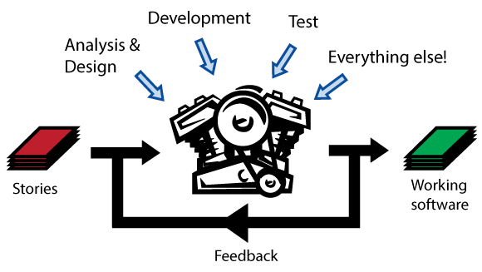
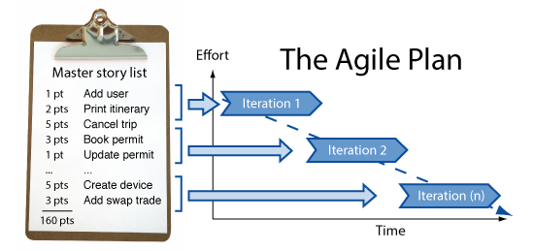
Iterations
An Agile iteration is a short 1 to 4 week period where a team takes a couple of their customers most important user stories and builds them completely as running-tested-software.
This means everything happens during an iteration. Analysis, design, coding, testing. It all happens here.
The beauty of working this way, is every couple weeks the customer gets something of great value (working software), but it's also a great way to track progress (measuring the rate at which the team can turn user stories into production ready working software).

Slide 58
Planning
The fine art of expectation setting

Slide 59
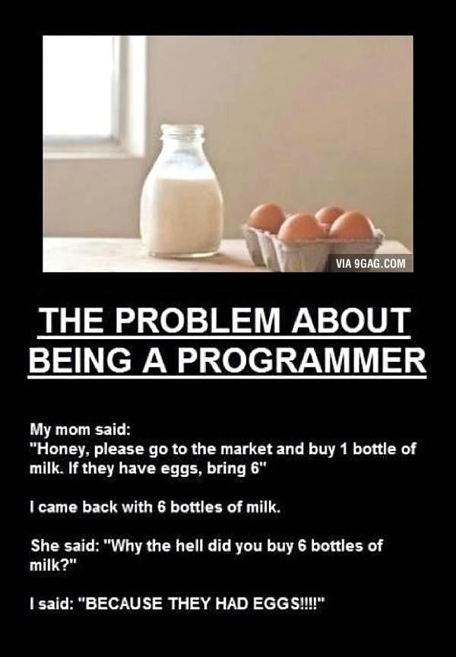

Slide 60
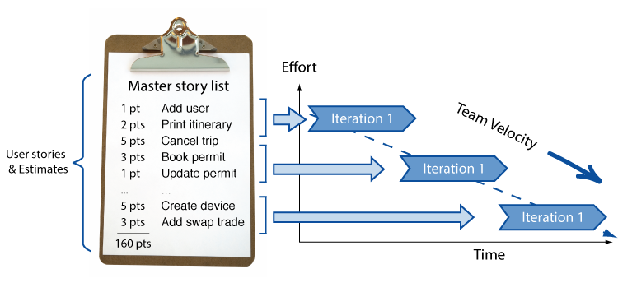
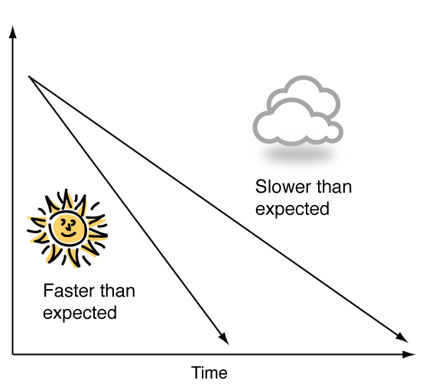
Planning
In its simplest form, agile planning is nothing more than measuring the speed a team can turn user stories into working, production-ready software and then using that to figure out when they’ll be done.
To give us a rough idea about delivery dates, we take the total effort for the project, divide it by our estimated team velocity, and calculate how many iterations we think we’ll require to deliver our project. This becomes our project plan.
# iterations = total effort / estimated team velocity
For example:
# iterations = 100 pts / 10 pts per iteration = 10 iterations
Now, as we start delivering, one of two things is going to happen. We are going to discover that we are going faster than expected or we are going slower than we originally thought.

Slide 61
Scrum

Slide 62
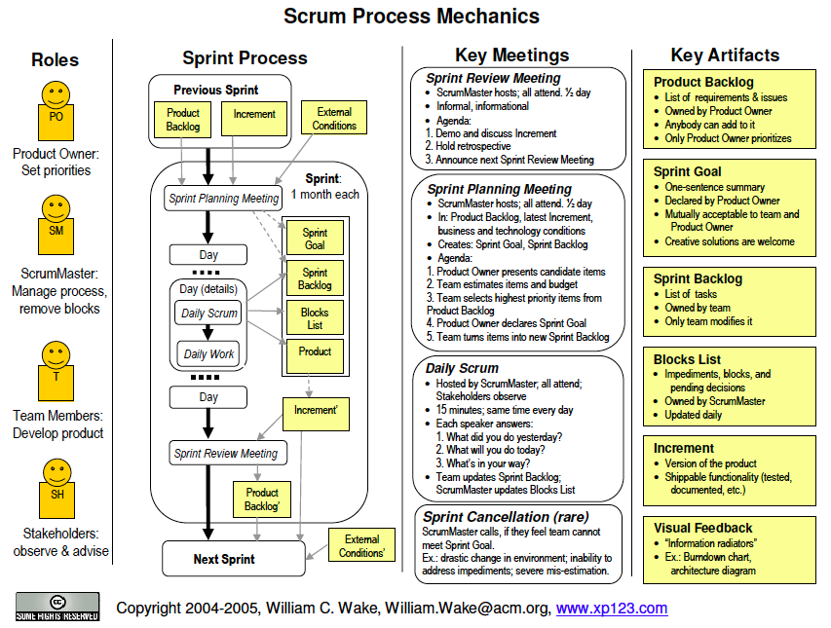

Slide 63
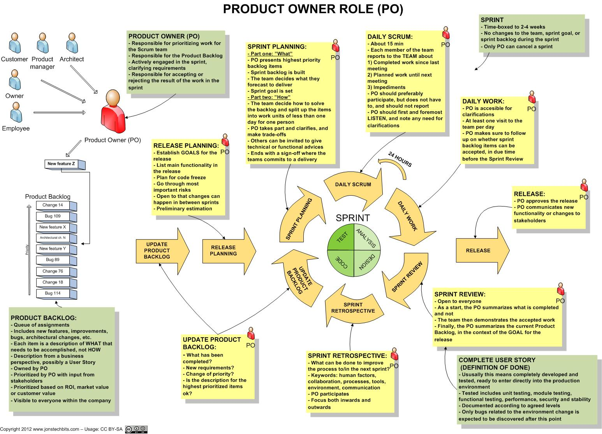

Slide 64
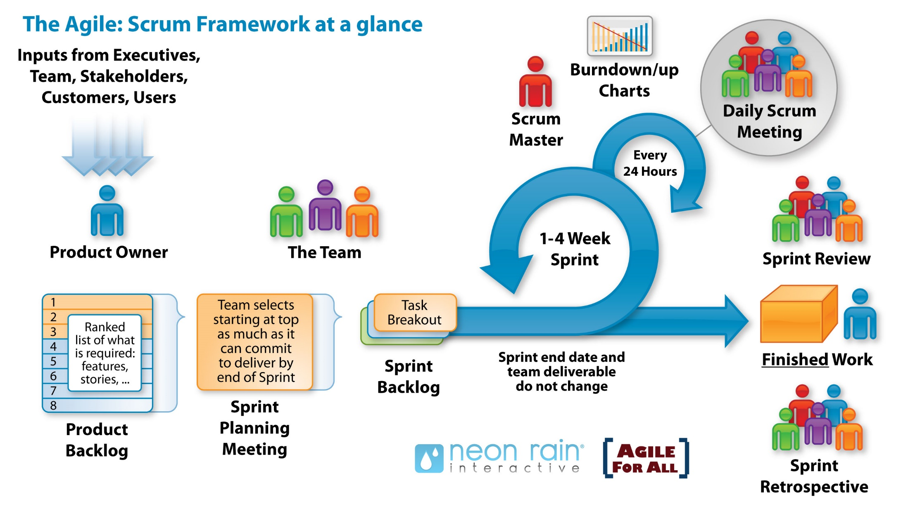

Slide 65
Exercise 7.5.1 – page 254 – 256
From “I am Agile - Klaus Nielsen”
What would you recommend in order to reduce the hindrances of working with staff in many time zones?
Leading and motivating distributed teams differs from leading and motivating collocated teams – What would you do differently as team member, product owner or project Manager?
Is the success of Igor only due to a more iterative approach of the software development and change of business model? Or, were there other factors involved?
PDF on fronter - Exercise 7.5.1.pdf

Slide 66
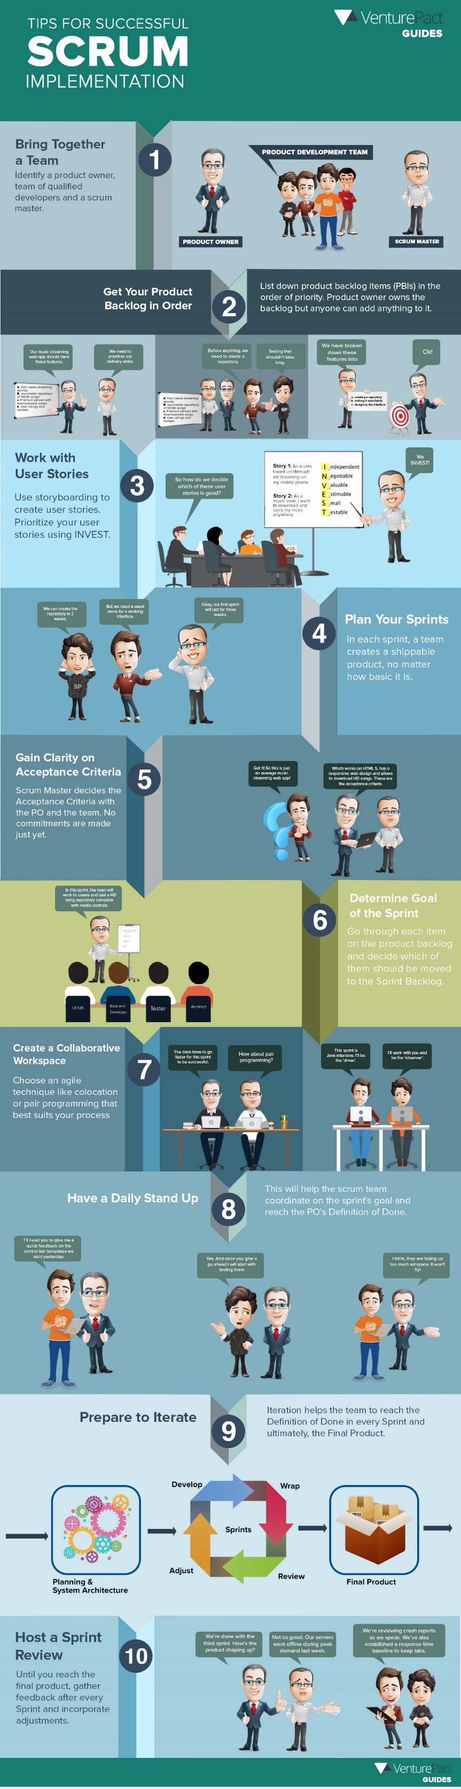

http://blog.venturepact.com/10-tips-for-successful-scrum-implementation

Slide 67
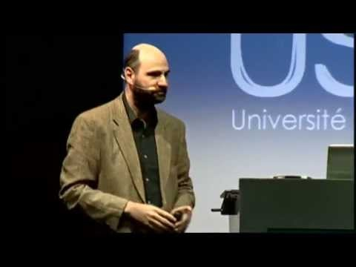
Video
Explaining Agile - Martin Fowler and Neil Ford at USI

Slide 68
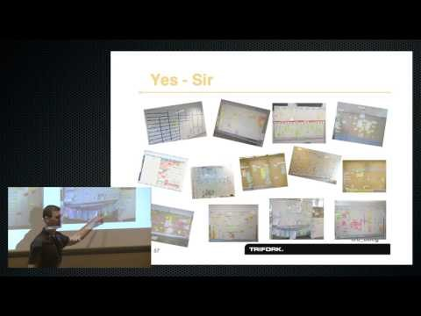
Video
My agile journey : XP, Scrum, Lean, Kanban and back again - Jesper Boeg

Slide 69
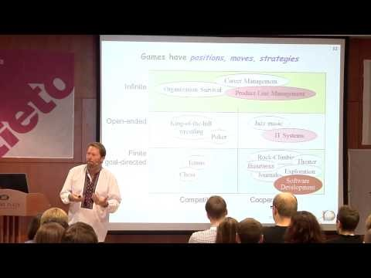
Video
Dr. Alistair Cockburn "Why Agile Works"

Slide 70
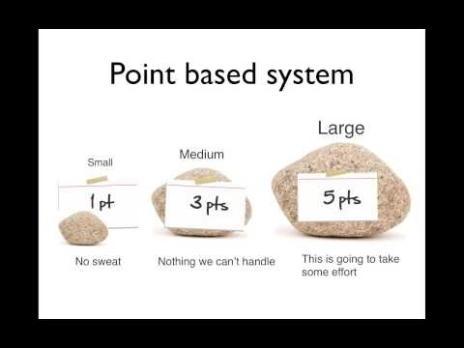
Agile Estimation

Slide 71
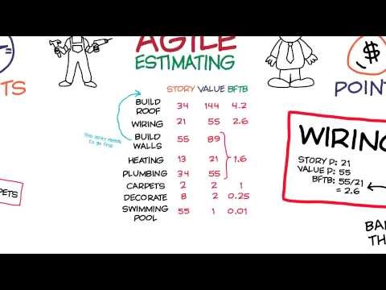
Learn agile estimation in 10 minutes

Slide 72
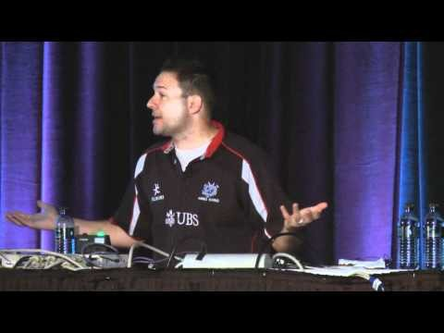
Agile Estimation - Microsoft TechEd North America 2011

Slide 73
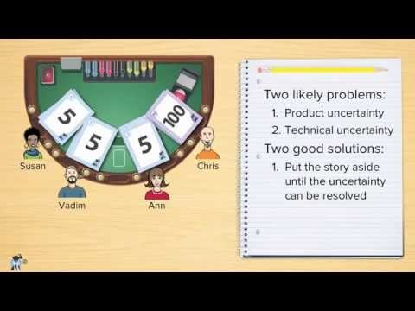
Agile Estimating and Planning: Planning Poker - Mike Cohn

